Slide 1
Your life in christ
Design for Discipleship – Book 5

Slide 2
WORSHIP IN SONG
John 4:24 God is spirit, and those who worship Him must worship in spirit and truth.”
Colossians 3:16 Let the word of Christ dwell in you richly, with all wisdom teaching and admonishing one another with psalms and hymns and spiritual songs, singing with gratefulness in your hearts to God.
Ephesians 5:19 [speak] to one another in psalms and hymns and spiritual songs, singing and making melody with your heart to the Lord; 20 always giving thanks for all things in the name of our Lord Jesus Christ to God, even the Father.

Slide 5
Paul to Timothy…
2 Timothy 3:¹⁴ But you, continue in the things you learned and became convinced of, knowing from whom you learned them, ¹⁵ and that from childhood you have known the sacred writings which are able to make you wise unto salvation through faith which is in Christ Jesus. ¹⁶ All Scripture is God-breathed and profitable for teaching, for reproof, for correction, for training in righteousness, ¹⁷ so that the man of God may be equipped, having been thoroughly equipped for every good work.

Slide 6
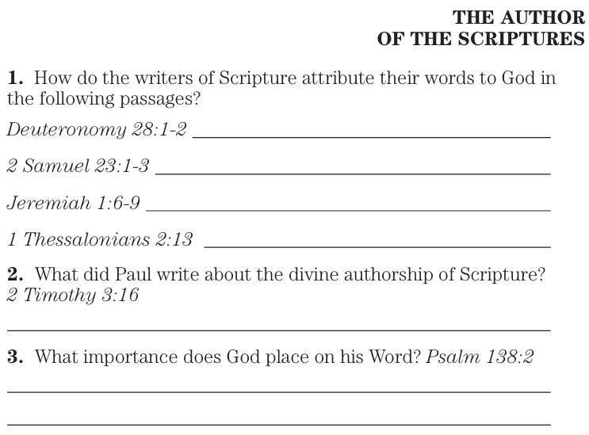
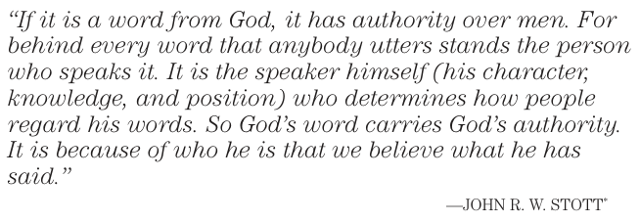
Deuteronomy 28:1 “Now it will be, if you diligently listen to the voice of Yahweh your God, being careful to do all His commandments which I am commanding you today, Yahweh your God will set you high above all the nations of the earth. 2 And all these blessings will come upon you and overtake you if you listen to the voice of Yahweh your God:
1 Thessalonians 2:13 And for this reason we also thank God without ceasing that when you received the word of God which you heard from us, you accepted it not as the word of men, but for what it really is, the word of God, which also is at work in you who believe.
2 Timothy 3:16 All Scripture is God-breathed and profitable for teaching, for reproof, for correction, for training in righteousness,
Psalm 138:2 I will worship toward Your holy temple
And give thanks to Your name for Your lovingkindness and Your truth; For You have magnified Your word according to all Your name.

Slide 7
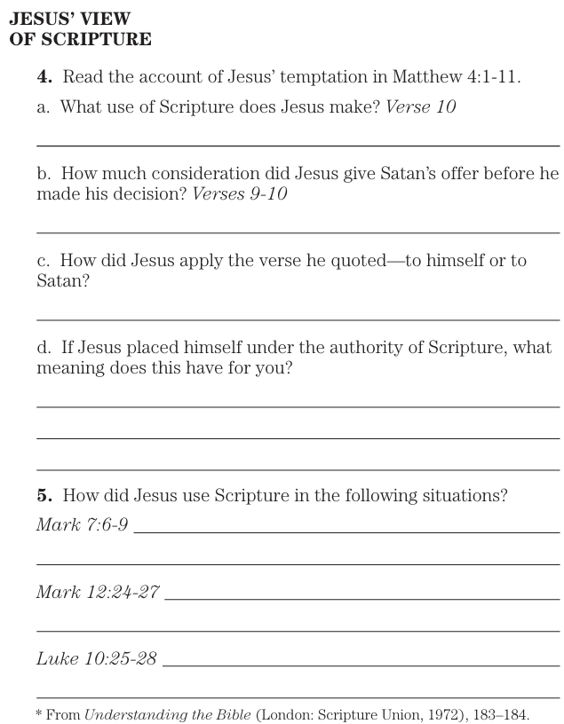
Matthew 4:4 Then Jesus was led up by the Spirit into the wilderness to be tempted by the devil. 2 And after He had fasted forty days and forty nights, He then became hungry. 3 And the tempter came and said to Him, “If You are the Son of God, command that these stones become bread.” 4 But He answered and said, “It is written, ‘Man shall not live on bread alone, but on every word that proceeds out of the mouth of God.’”
5 Then the devil *took Him into the holy city and had Him stand on the pinnacle of the temple, 6 and *said to Him, “If You are the Son of God, throw Yourself down; for it is written,
‘He will command His angels concerning You’;
and
‘On their hands they will bear You up,
Lest You strike Your foot against a stone.’”
7 Jesus said to him, “Again, it is written, ‘You shall not put the Lord your God to the test.’”
8 Again, the devil *took Him to a very high mountain and *showed Him all the kingdoms of the world and their glory; 9 and he said to Him, “All these things I will give You, if You fall down and worship me.” 10 Then Jesus *said to him, “Go, Satan! For it is written, ‘You shall worship the Lord your God, and serve Him only.’” 11 Then the devil *left Him; and behold, angels came and began to minister to Him.

Slide 8
Mark 7:6 And He said to them, “Rightly did Isaiah prophesy of you hypocrites, as it is written:
‘This people honors Me with their lips,
But their heart is far away from Me.
7 But in vain do they worship Me,
Teaching as doctrines the commands of men.’
8 Leaving the commandment of God, you hold to the tradition of men.”
9 And He was also saying to them, “You are good at setting aside the commandment of God in order to keep your tradition.
Luke 10:25 And behold, a scholar of the Law stood up and was putting Him to the test, saying, “Teacher, what shall I do to inherit eternal life?” 26 And He said to him, “What is written in the Law? How do you read it?” 27 And he answered and said, “You shall love the Lord your God with all your heart, and with all your soul, and with all your strength, and with all your mind; and your neighbor as yourself.” 28 And He said to him, “You have answered correctly; do this and you will live.”
Mark 12:24 Jesus said to them, “Is this not the reason you are mistaken, that you do not understand the Scriptures nor the power of God? 25 For when they rise from the dead, they neither marry nor are given in marriage, but are like angels in heaven. 26 But regarding the fact that the dead are raised, have you not read in the book of Moses, in the passage about the burning bush, how God spoke to him, saying, ‘I am the God of Abraham, and the God of Isaac, and the God of Jacob’? 27 He is not the God of the dead, but of the living; you are greatly mistaken.”

Slide 9
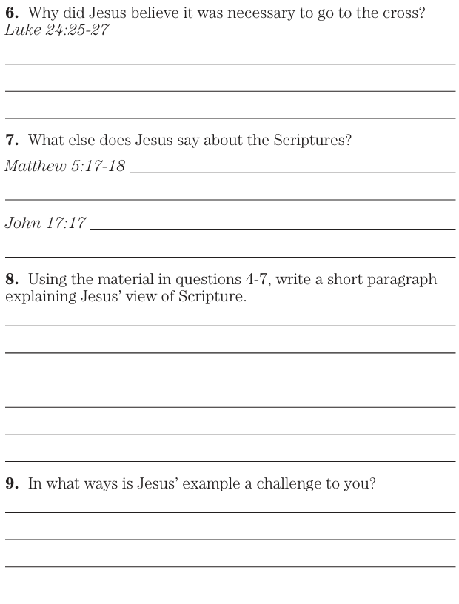
Luke 24:25 And He said to them, “O foolish ones and slow of heart to believe in all that the prophets have spoken! 26 Was it not necessary for the Christ to suffer these things and to enter into His glory?” 27 Then beginning with Moses and with all the prophets, He interpreted to them the things concerning Himself in all the Scriptures.
Matthew 5:17 “Do not think that I came to abolish the Law or the Prophets; I did not come to abolish but to fulfill. 18 For truly I say to you, until heaven and earth pass away, not [a]the smallest letter or stroke shall pass from the Law until all is accomplished.
John 17:17 Sanctify them by the truth; Your word is truth.

Slide 10
The Sadducees and the Resurrection Matthew 22:²³ On that day some Sadducees (who say there is no resurrection) came to Jesus and asked Him a question, ²⁴ saying, “Teacher, Moses said, ‘If a man dies having no children, his brother as next of kin shall marry his wife and raise up a seed for his brother.’ ²⁵ Now there were seven brothers with us; and the first married and died, and having no seed, he left his wife to his brother; ²⁶ so also the second, and the third, down to the seventh. ²⁷ And last of all, the woman died. ²⁸ In the resurrection, therefore, whose wife of the seven will she be? For they all had married her.” ²⁹ But Jesus answered and said to them, “You are mistaken, not understanding the Scriptures nor the power of God. ³⁰ For in the resurrection they neither marry nor are given in marriage, but are like angels in heaven. ³¹ But regarding the resurrection of the dead, have you not read what was spoken to you by God, saying, ³² ‘I am the God of Abraham, and the God of Isaac, and the God of Jacob’? He is not the God of the dead but of the living.” ³³ And when the crowds heard this, they were astonished at His teaching.

Slide 11
Joshua 23:14 “Now behold, today I am going the way of all the earth, and you know in all your hearts and in all your souls that not one word of all the good words which Yahweh your God spoke concerning you has failed; all have come to pass for you; not one word of them has failed.
Psalm 33:4 For the word of Yahweh is upright,
And all His work is done in faithfulness.
Proverbs 30:5 Every word of God is tested;
He is a shield to those who take refuge in Him.
6 Do not add to His words
Lest He reprove you, and you be proved a liar.
Luke 1:1 Inasmuch as many have undertaken to compile an account of the things that have been fulfilled among us, 2 just as those, who from the beginning were eyewitnesses and servants of the [d]word, handed them down to us, 3 it seemed fitting for me as well, having investigated everything carefully from the beginning, to write it out for you in orderly sequence, most excellent Theophilus, 4 so that you may know the certainty about the things you have been taught.

Slide 12
2 Peter 1:15 And I will also be diligent that at any time after my departure you will be able to call these things to mind.
16 For we did not make known to you the power and coming of our Lord Jesus Christ, following cleverly devised myths, but being eyewitnesses of His majesty. 17 For when He received honor and glory from God the Father, such an utterance as this was made to Him by the Majestic Glory, “This is My beloved Son with whom I am well-pleased”— 18 and we ourselves heard this utterance made from heaven when we were with Him on the holy mountain.
19 And we have as more sure the prophetic word, to which you do well to pay attention as to a lamp shining in a dark place, until the day dawns and the morning star arises in your hearts. 20 Know this first of all, that no prophecy of Scripture comes by one’s own interpretation. 21 For no prophecy was ever made by the will of man, but men being moved by the Holy Spirit spoke from God.
Matthew 17:1 And six days later Jesus *brought with Him Peter and James and John his brother, and *led them up on a high mountain by themselves. 2 And He was transfigured before them; and His face shone like the sun, and His garments became as white as light. 3 And behold, Moses and Elijah appeared to them, talking with Him. 4 And Peter answered and said to Jesus, “Lord, it is good for us to be here; if You wish, I will make three [a]booths here, one for You, and one for Moses, and one for Elijah.” 5 While he was still speaking, behold, a bright cloud overshadowed them, and behold, a voice out of the cloud said, “This is My beloved Son, with whom I am well-pleased; listen to Him!” 6 And when the disciples heard this, they fell on their faces and were terrified. 7 And Jesus came to them and touched them and said, “Get up, and do not be afraid.” 8 And lifting up their eyes, they saw no one except Jesus Himself alone.
9 And as they were coming down from the mountain, Jesus commanded them, saying, “Tell the vision to no one until the Son of Man has risen from the dead.”

Slide 13
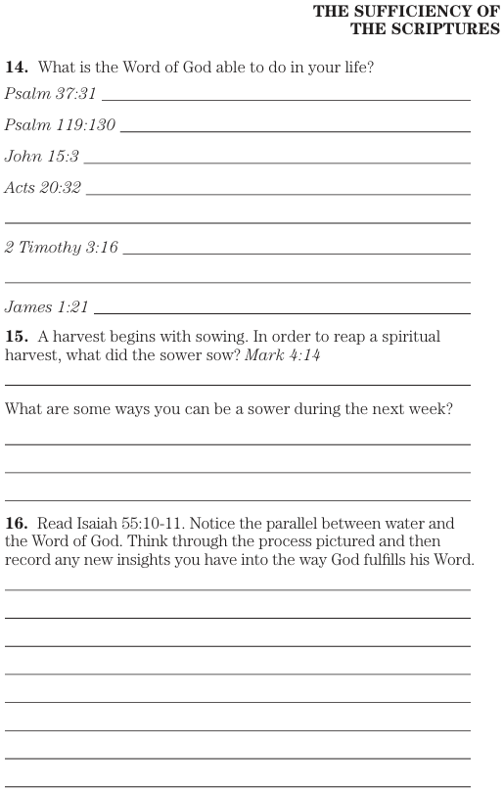
Psalm 37:31 The law of his God is in his heart; His steps do not slip.
Psalm 119:130 The unfolding of Your words gives light; It gives understanding to the simple.
John 15:3 You are already clean because of the word which I have spoken to you.
Acts 20:32 And now I commend you to God and to the word of His grace, which is able to build you up and to give you the inheritance among all those who have been sanctified.
2 Timothy 316 All Scripture is God-breathed and profitable for teaching, for reproof, for correction, for training in righteousness,
James 1:21 Therefore, laying aside all filthiness and all [a]that remains of wickedness, in gentleness receive the implanted word, which is able to save your souls.
Mark 4:14 The sower sows the word.
Isaiah 55:10 For as the rain and the snow come down from heaven, and do not return there without watering the earth and making it bear and sprout, and giving seed to the sower and bread to the eater, 11 So will My word be which goes forth from My mouth; It will not return to Me empty, without accomplishing what pleases Me, and without succeeding in the matter for which I sent it.

Slide 14
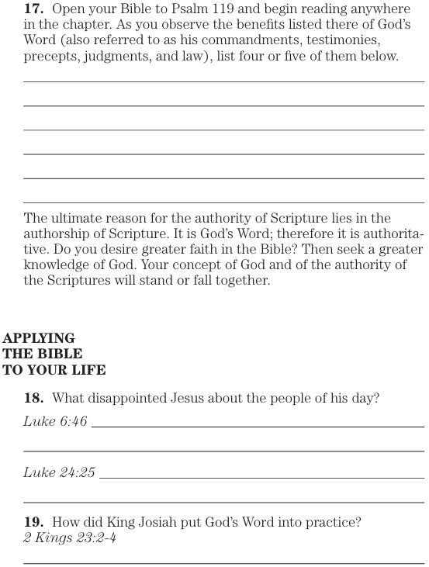
Psalm 119 176 verses
Luke 6:46 “Now why do you call Me, ‘Lord, Lord,’ and do not do what I say?
Luke 24:25 And He said to them, “O foolish ones and slow of heart to believe in all that the prophets have spoken!
2 Kings 23:2 And the king went up to the house of Yahweh and all the men of Judah and all the inhabitants of Jerusalem with him, and the priests and the prophets and all the people, both small and great; and he read in their hearing all the words of the book of the covenant which was found in the house of Yahweh. 3 Then the king stood by the pillar and cut a covenant before Yahweh, to walk after Yahweh, and to keep His commandments and His testimonies and His statutes with all his heart and all his soul, to establish the words of this covenant that were written in this book. And all the people entered into the covenant.
4 Then the king commanded Hilkiah the high priest and the priests of the second order and the doorkeepers, to bring out of the temple of Yahweh all the vessels that were made for Baal, for Asherah, and for all the host of heaven; and he burned them outside Jerusalem in the fields of the Kidron, and carried their ashes to Bethel.

Slide 15
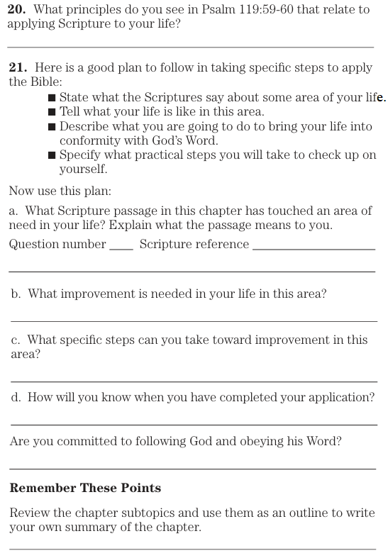
Psalm 119:59 I thought upon my ways and I turned my feet to Your testimonies.
60 I hastened and did not delay to keep Your commandments.

