Slide 1
Your life in christ
Design for Discipleship – Book 5

Slide 2
WORSHIP IN SONG
John 4:24 God is spirit, and those who worship Him must worship in spirit and truth.”
Colossians 3:16 Let the word of Christ dwell in you richly, with all wisdom teaching and admonishing one another with psalms and hymns and spiritual songs, singing with gratefulness in your hearts to God.
Ephesians 5:19 [speak] to one another in psalms and hymns and spiritual songs, singing and making melody with your heart to the Lord; 20 always giving thanks for all things in the name of our Lord Jesus Christ to God, even the Father.

Slide 4
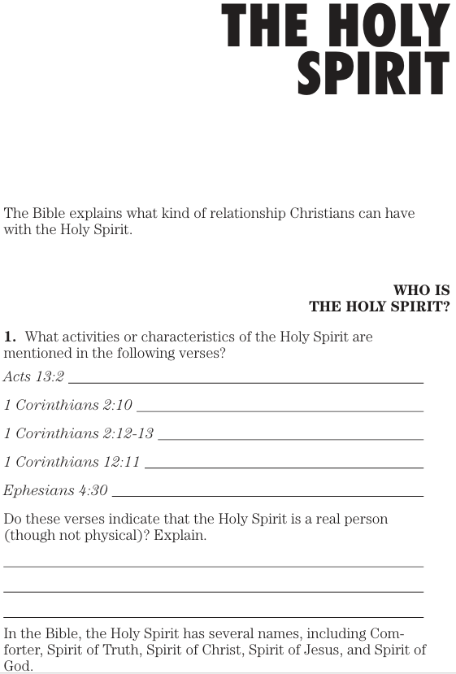
Acts 13:2 And while they were ministering to the Lord and fasting, the Holy Spirit said, “Set apart for Me Barnabas and Saul for the work to which I have called them.”
1 Corinthians 2:10 But to us God revealed them through the Spirit, for the Spirit searches all things, even the depths of God…
12 Now we have received, not the spirit of the world, but the Spirit who is from God, so that we may know the depths graciously given to us by God, 13 of which depths we also speak, not in words taught by human wisdom, but in those taught by the Spirit, combining spiritual depths with spiritual words.
1 Corinthians 12:11 But one and the same Spirit works all these things, distributing to each one individually just as He wills.
Ephesians 4:30 And do not grieve the Holy Spirit of God, by whom you were sealed for the day of redemption.

Slide 5
Genesis 1: 2 And the earth was formless and void, and darkness was over the surface of the deep, and the Spirit of God was hovering over the surface of the waters.
Hebrews 9:4 having a golden altar of incense and the ark of the covenant covered on all sides with gold, in which was a golden jar holding the manna, and Aaron’s rod which budded, and the tablets of the covenant.
Psalm 139:7 Where can I go from Your Spirit? Or where can I flee from Your presence? 8 If I ascend to heaven, You are there; If I make my bed in Sheol, behold, You are there.
Acts 5:1 But a man named Ananias, with his wife Sapphira, sold a piece of property, 2 and kept back some of the price for himself, with his wife’s full knowledge. And bringing a portion of it, he laid it at the apostles’ feet. 3 But Peter said, “Ananias, why has Satan filled your heart to lie to the Holy Spirit and to keep back some of the price of the land? 4 While it remained unsold, did it not remain your own? And after it was sold, was it not under your authority? Why is it that you laid this deed in your heart? You have not lied to men but to God.” 5 And as he heard these words, Ananias fell down and breathed his last; and great fear came over all who heard. 6 And the young men rose up and wrapped him up, and after carrying him out, they buried him.
7 Now there was an interval of about three hours, and his wife came in, not knowing what had happened. 8 And Peter responded to her, “Tell me whether you were paid this much for the land?” And she said, “Yes, that much.” 9 Then Peter said to her, “Why is it that you have agreed together to put the Spirit of the Lord to the test? Behold, the feet of those who buried your husband are at the door, and they will carry you out as well.” 10 And immediately she fell at his feet and breathed her last, and the young men came in and found her dead, and they carried her out and buried her beside her husband.
Acts 5:1-10

Slide 6
John 1:14 And the Word became flesh, and dwelt among us, and we beheld His glory, glory as of the only begotten from the Father, full of grace and truth. 15 John *bore witness about Him and cried out, saying, “This was He of whom I said, ‘He who comes after me has been ahead of me, for He existed before me.’” 16 For of His fullness we have all received, and grace upon grace. 17 For the Law was given through Moses; grace and truth came through Jesus Christ. 18 No one has seen God at any time; the only begotten God who is in the bosom of the Father, He has explained Him.
Hebrews 1 God, having spoken long ago to the fathers in the prophets in many portions and in many ways, 2 in these last days spoke to us in His Son, whom He appointed heir of all things, through whom also He made the worlds, 3 who is the radiance of His glory and the exact representation of His nature, and upholds all things by the word of His power; who, having accomplished cleansing for sins, sat down at the right hand of the Majesty on high, 4 having become so much better than the angels, as He has inherited a more excellent name than they.
John 16:8 And He, when He comes, will convict the world concerning sin and righteousness and judgment;
1 Corinthians 2:10 But to us God revealed them through the Spirit, for the Spirit searches all things, even the depths of God. 11 For who among men knows the depths of a man except the spirit of the man which is in him? Even so the depths of God no one knows except the Spirit of God.
1 Corinthians 6:19 Or do you not know that your body is a sanctuary of the Holy Spirit who is in you, whom you have from God, and that you are not your own? 20 For you were bought with a price: therefore glorify God in your body.
Matthew 3:16 And after being baptized, Jesus came up immediately from the water; and behold, the heavens were opened, and he saw the Spirit of God descending like a dove and coming upon Him, 17 and behold, there was a voice out of the heavens saying, “This is My beloved Son, in whom I am well-pleased.”
Matthew 28: 19 Go therefore and make disciples of all the nations, baptizing them in the name of the Father and the Son and the Holy Spirit,
John 14:6 Jesus *said to him, “I am the way, and the truth, and the life. No one comes to the Father but through Me.
2 Corinthians 13:14 The grace of the Lord Jesus Christ, and the love of God, and the fellowship of the Holy Spirit, be with you all.
1 Peter 1:2 according to the foreknowledge of God the Father, by the sanctifying work of the Spirit, to the obedience of Jesus Christ and the sprinkling of His blood: May grace and peace be multiplied to you.

Slide 7
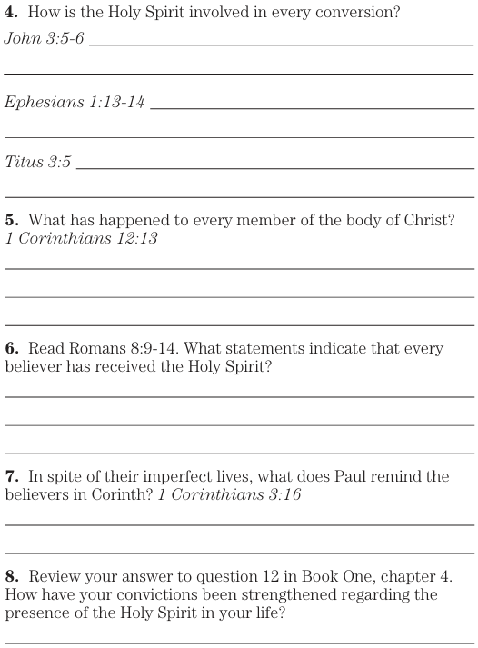
John 3:5 Jesus answered, “Truly, truly, I say to you, unless one is born of water and the Spirit he cannot enter into the kingdom of God. 6 That which has been born of the flesh is flesh, and that which has been born of the Spirit is spirit.
Ephesians 1:13 In Him, you also, after listening to the word of truth, the gospel of your salvation—having also believed, you were sealed in Him with the Holy Spirit of promise, 14 who is given as a pledge of our inheritance, unto the redemption of God’s own possession, to the praise of His glory.
Titus 3:5 He saved us, not by works which we did in righteousness, but according to His mercy, through the washing of regeneration and renewing by the Holy Spirit,
1 Corinthians 12:3 Therefore I make known to you that no one speaking by the Spirit of God says, “Jesus is accursed,” and no one can say, “Jesus is Lord,” except by the Holy Spirit.
Romans 8:9 However, you are not in the flesh but in the Spirit, if indeed the Spirit of God dwells in you. But if anyone does not have the Spirit of Christ, he does not belong to Him. 10 But if Christ is in you, though the body is dead because of sin, yet the spirit is alive because of righteousness. 11 But if the Spirit of Him who raised Jesus from the dead dwells in you, He who raised Christ Jesus from the dead will also give life to your mortal bodies through His Spirit who dwells in you. 12 So then, brothers, we are under obligation, not to the flesh, to live according to the flesh— 13 for if you are living according to the flesh, you must die, but if by the Spirit you are putting to death the practices of the body, you will live. 14 For as many as are being led by the Spirit of God, these are sons of God.
1 Corinthians 3:16 Do you not know that you are a sanctuary of God and that the Spirit of God dwells in you?

Slide 8
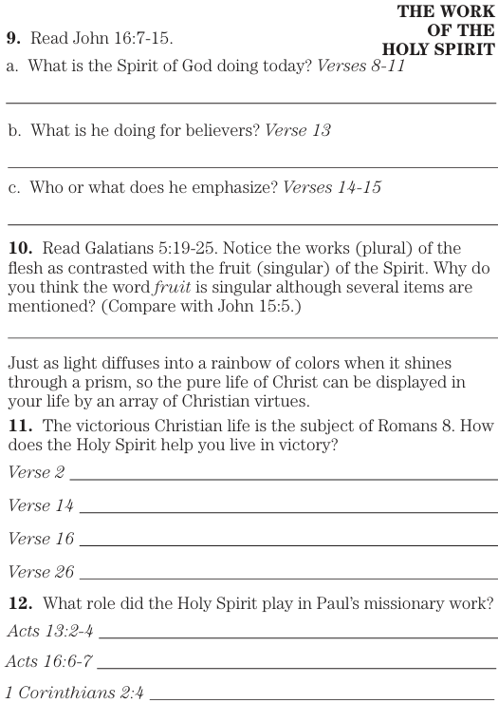
John 16:7 But I tell you the truth, it is to your advantage that I go away; for if I do not go away, the Advocate will not come to you; but if I go, I will send Him to you. 8 And He, when He comes, will convict the world concerning sin and righteousness and judgment; 9 concerning sin, because they do not believe in Me; 10 and concerning righteousness, because I go to the Father and you no longer see Me; 11 and concerning judgment, because the ruler of this world has been judged. 12 “I still have many more things to say to you, but you cannot bear them now. 13 But when He, the Spirit of truth, comes, He will guide you into all the truth; for He will not speak from Himself, but whatever He hears, He will speak; and He will disclose to you what is to come. 14 He will glorify Me, for He will take of Mine and will disclose it to you. 15 All things that the Father has are Mine; therefore I said that He takes of Mine and will disclose it to you.
Galatians 5:19 Now the deeds of the flesh are evident, which are: sexual immorality, impurity, sensuality, 20 idolatry, sorcery, enmities, strife, jealousy, outbursts of anger, selfish ambition, dissensions, factions, 21 envying, drunkenness, carousing, and things like these, of which I forewarn you, just as I have forewarned you, that those who practice such things will not inherit the kingdom of God. 22 But the fruit of the Spirit is love, joy, peace, patience, kindness, goodness, faithfulness, 23 gentleness, self-control. Against such things there is no law. 24 Now those who belong to Christ Jesus crucified the flesh with its passions and desires. 25 If we live by the Spirit, let us also walk in step with the Spirit.
John 15:5 I am the vine, you are the branches; he who abides in Me and I in him, he bears much fruit, for apart from Me you can do nothing.

Slide 9
Acts 13:2 And while they were ministering to the Lord and fasting, the Holy Spirit said, “Set apart for Me Barnabas and Saul for the work to which I have called them.” 3 Then, when they had fasted and prayed and laid their hands on them, they sent them away. 4 So, being sent out by the Holy Spirit, they went down to Seleucia and from there they sailed to Cyprus.
Acts 16:6 And they passed through the Phrygian and Galatian region, having been forbidden by the Holy Spirit to speak the word in Asia; 7 and after they came to Mysia, they were trying to go into Bithynia, and the Spirit of Jesus did not permit them;
1 Corinthians 2:4 and my word and my preaching were not in persuasive words of wisdom, but in demonstration of the Spirit and of power,

Slide 10
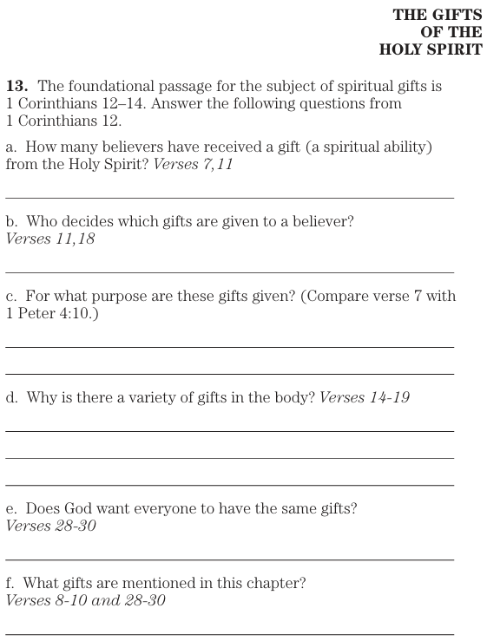
1 Corinthians 12: 12 Now concerning spiritual gifts, brothers, I do not want you to be ignorant. 2 You know that when you were pagans, you were being led astray to the mute idols, however you were led. 3 Therefore I make known to you that no one speaking by the Spirit of God says, “Jesus is accursed,” and no one can say, “Jesus is Lord,” except by the Holy Spirit.
4 Now there are varieties of gifts, but the same Spirit. 5 And there are varieties of ministries, and the same Lord. 6 And there are varieties of workings, but the same God who works everything in everyone. 7 But to each one is given the manifestation of the Spirit for what is profitable. 8 For to one is given the word of wisdom through the Spirit, and to another the word of knowledge according to the same Spirit; 9 to someone else faith by the same Spirit, and to another gifts of healing by the one Spirit, 10 and to another the workings of miracles, and to another prophecy, and to another the distinguishing of spirits, to someone else various kinds of tongues, and to another the translation of tongues. 11 But one and the same Spirit works all these things, distributing to each one individually just as He wills.
12 For even as the body is one and yet has many members, and all the members of the body, though they are many, are one body, so also is Christ. 13 For also by one Spirit we were all baptized into one body, whether Jews or Greeks, whether slaves or free, and we were all made to drink of one Spirit.
14 For also the body is not one member, but many. 15 If the foot says, “Because I am not a hand, I am not a part of the body,” it is not for this reason any the less a part of the body. 16 And if the ear says, “Because I am not an eye, I am not a part of the body,” it is not for this reason any the less a part of the body. 17 If the whole body were an eye, where would the hearing be? If the whole were hearing, where would the sense of smell be? 18 But now God has appointed the members, each one of them, in the body, just as He desired. 19 And if they were all one member, where would the body be? 20 But now there are many members, but one body. 21 And the eye cannot say to the hand, “I have no need of you”; or again the head to the feet, “I have no need of you.” 22 On the contrary, how much more is it that the members of the body which seem to be weaker are necessary, 23 and those members of the body which we think as less honorable, on these we bestow more abundant honor, and our less presentable members become much more presentable, 24 whereas our more presentable members have no such need. But God has so composed the body, giving more abundant honor to that member which lacked, 25 so that there may be no [m]division in the body, but that the members may have the same care for one another. 26 And if one member suffers, all the members suffer with it; if one member is honored, all the members rejoice with it.
27 Now you are Christ’s body, and individually members of it. 28 And God has appointed in the church, first apostles, second prophets, third teachers, then [p]miracles, then gifts of healings, helps, administrations, various kinds of tongues. 29 Are all apostles? Are all prophets? Are all teachers? Are all workers of miracles? 30 Do all have gifts of healings? Do all speak with tongues? Do all translate? 31 But you earnestly desire the greater gifts. And I will yet show you a more excellent way.
1 Corinthians 12 - Legacy Standard Bible

Slide 11
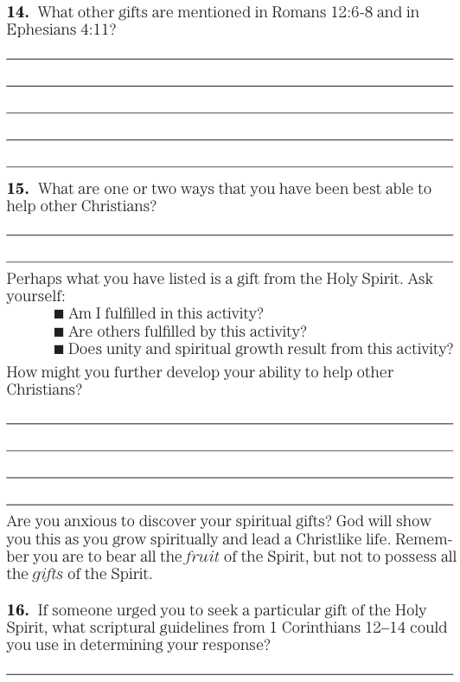
Ephesians 2:20 having been built on the foundation of the apostles and prophets, Christ Jesus Himself being the corner stone,
Ephesians 4:11 And He Himself gave some as apostles, and some as prophets, and some as evangelists, and some as pastors and teachers,
Romans 12:6 but having gifts that differ according to the grace given to us: whether prophecy, in agreement with the faith; 7 or service, in his serving; or he who teaches, in his teaching; 8 or he who exhorts, in his exhortation; he who gives, with generosity; he who leads, with diligence; he who shows mercy, with cheerfulness.

Slide 12
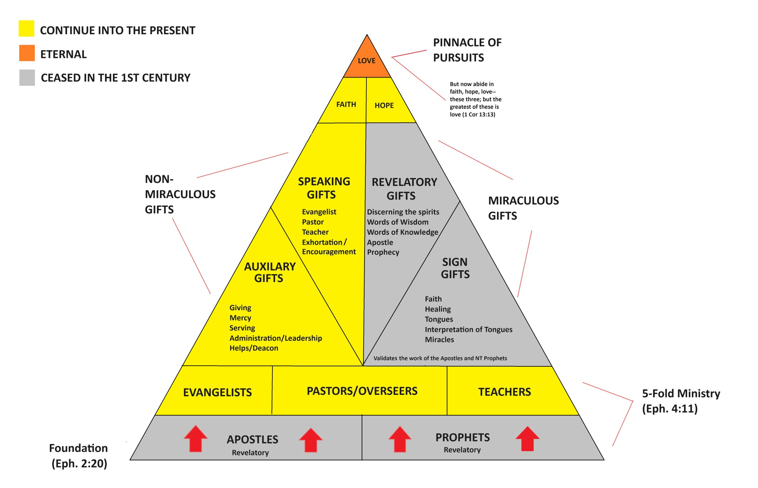

Slide 13
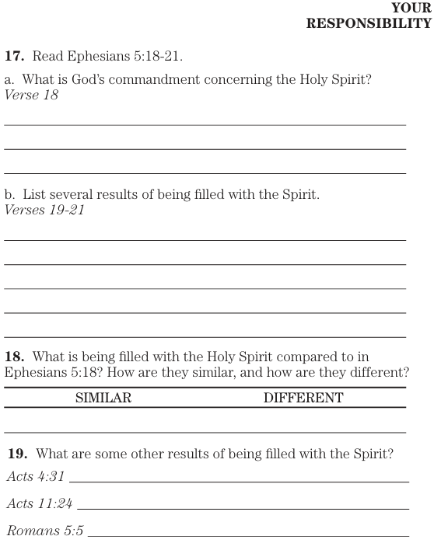
Ephesians 5:18 And do not get drunk with wine, for that is dissipation, but be filled with the Spirit, 19 speaking to one another in psalms and hymns and spiritual songs, singing and making melody with your heart to the Lord; 20 always giving thanks for all things in the name of our Lord Jesus Christ to God, even the Father; 21 and being subject to one another in the fear of Christ.
Acts 4:31 And when they had prayed earnestly, the place where they had gathered together was shaken, and they were all filled with the Holy Spirit and began to speak the word of God with confidence.
Acts 11:24 for he was a good man, and full of the Holy Spirit and of faith. And a considerable crowd was brought to the Lord.
Romans 5:5 and hope does not put to shame, because the love of God has been poured out within our hearts through the Holy Spirit who was given to us.

Slide 14
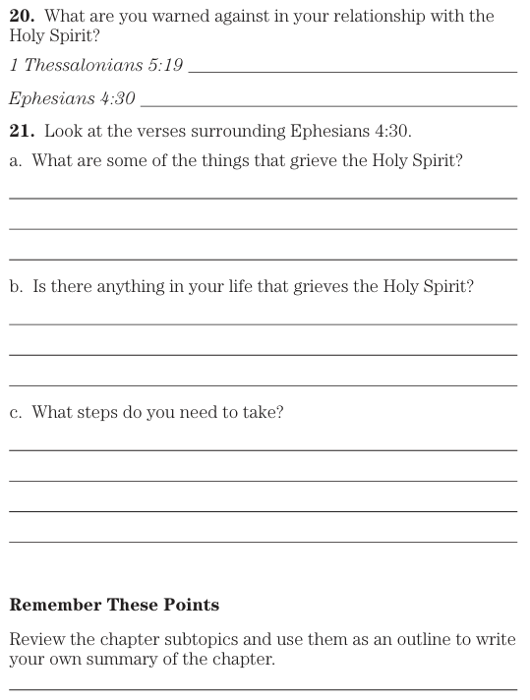
1 Thessalonians 5:19 Do not quench the Spirit;
Ephesians 4:30 And do not grieve the Holy Spirit of God, by whom you were sealed for the day of redemption.

