Slide 1
WORSHIP IN SONG
Praise to the Lord, The Almighty https://youtu.be/VGAaRtkovZQ?si=WqUSFx2zkiEVnHSt
John 4:24 God is spirit, and those who worship Him must worship in spirit and truth.”
Colossians 3:16 Let the word of Christ dwell in you richly, with all wisdom teaching and admonishing one another with psalms and hymns and spiritual songs, singing with gratefulness in your hearts to God.
Ephesians 5:19 [speak] to one another in psalms and hymns and spiritual songs, singing and making melody with your heart to the Lord; 20 always giving thanks for all things in the name of our Lord Jesus Christ to God, even the Father.

Slide 2
Your life in christ
Design for Discipleship – Book 3

Slide 5
John 13:13 You call Me Teacher and Lord; and you are right, for so I am.
Acts 2:36 Therefore let all the house of Israel know for certain that God has made Him both Lord and Christ—this Jesus whom you crucified.”
Revelation 19:16 And He has on His garment and on His thigh a name written, “KING OF KINGS, AND LORD OF LORDS.”
Colossians 1:16 For in Him all things were created, both in the heavens and on earth, visible and invisible, whether thrones or dominions or rulers or authorities—all things have been created through Him and for Him. 17 And He is before all things, And in Him all things hold together. 18 And He is the head of the body, the church; Who is the beginning, the firstborn from the dead, so that He Himself will come to have first place in everything.
Romans 14:9 For to this end Christ died and lived again, that He might be Lord both of the dead and of the living.

Slide 6
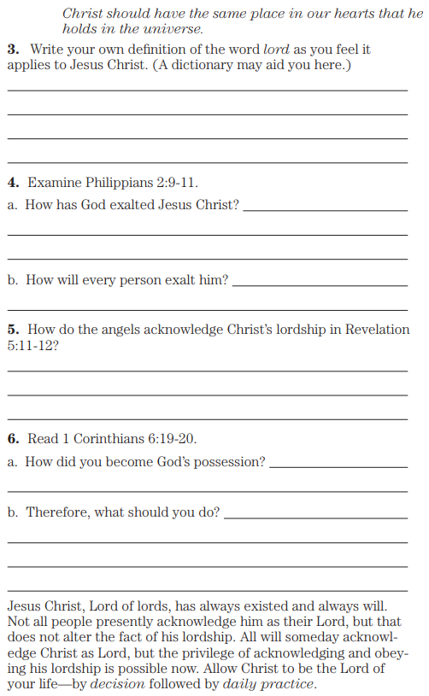
Philippians 2:9 Therefore, God also highly exalted Him, and bestowed on Him the name which is above every name, 10 so that at the name of Jesus every knee will bow, of those who are in heaven and on earth and under the earth, 11 and that every tongue will confess that Jesus Christ is Lord, to the glory of God the Father.
Revelation 5:11 Then I looked, and I heard the voice of many angels around the throne and the living creatures and the elders; and the number of them was myriads of myriads, and thousands of thousands, 12 saying with a loud voice, “Worthy is the Lamb that was slain to receive power and riches and wisdom and strength and honor and glory and blessing.”
1 Corinthians 6:19 Or do you not know that your body is a sanctuary of the Holy Spirit who is in you, whom you have from God, and that you are not your own? 20 For you were bought with a price: therefore glorify God in your body.

Slide 7
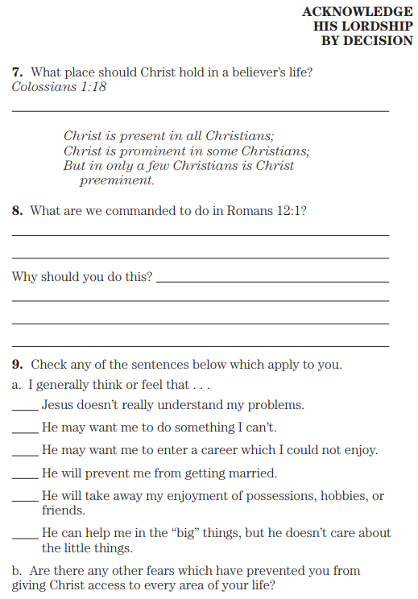
Colossians 1:18 And He is the head of the body, the church;
Who is the beginning, the firstborn from the dead, so that He Himself will come to have first place in everything.
Romans 12:1 Therefore I exhort you, brothers, by the mercies of God, to present your bodies as a sacrifice—living, holy, and pleasing to God, which is your spiritual service of worship.

Slide 8
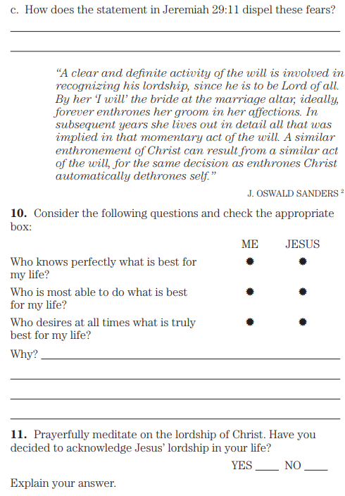
Jeremiah 29:11 For I know the plans that I have for you,’ declares Yahweh, ‘plans for peace and not for calamity, to give you a future and a hope.

Slide 9
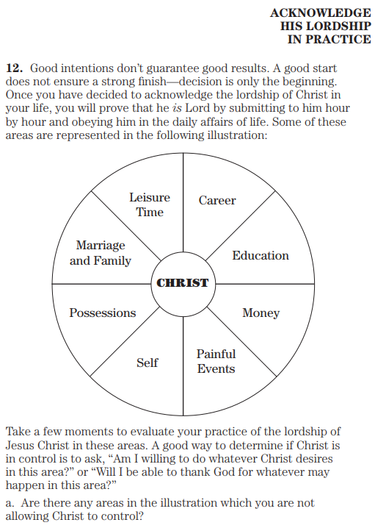

Slide 10
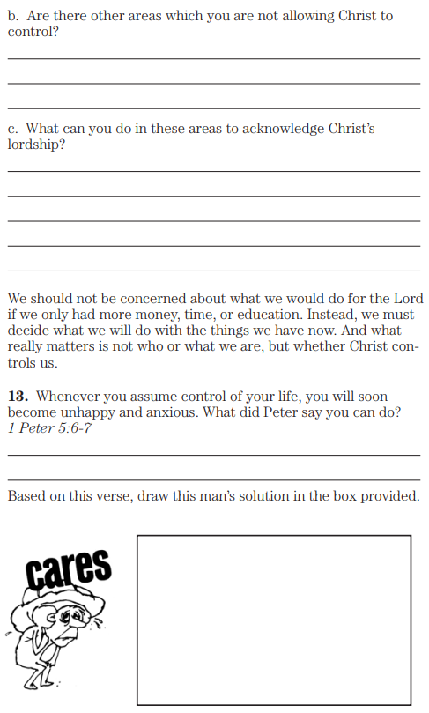
1 Peter 5:6 Therefore humble yourselves under the mighty hand of God, that He may exalt you at the proper time, 7 casting all your anxiety on Him, because He cares for you.

Slide 11
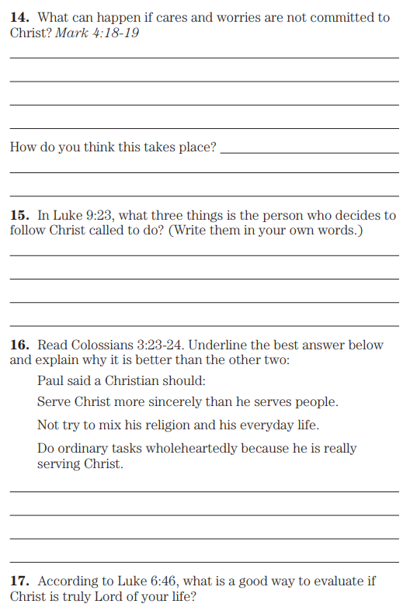
Mark 4:18 And others are those being sown among the thorns; these are the ones who have heard the word, 19 but the worries of the world, and the deceitfulness of riches, and the desires for anything else enter in and choke the word, and it becomes unfruitful.
Luke 9:23 And He was saying to them all, “If anyone wishes to come after Me, let him deny himself, and take up his cross daily and follow Me.
Colossians 3:23 Whatever you do, do your work heartily, as for the Lord rather than for men, 24 knowing that from the Lord you will receive the reward of the inheritance. Serve the Lord Christ.
Luke 6:46 “Now why do you call Me, ‘Lord, Lord,’ and do not do what I say?

Slide 12
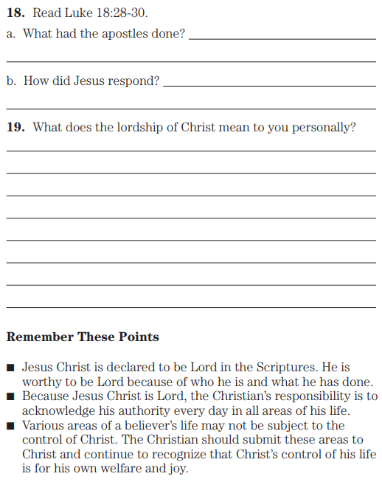
Luke 18:28 And Peter said, “Behold, we have left all that is our own and followed You.” 29 And He said to them, “Truly I say to you, there is no one who has left house or wife or brothers or parents or children, for the sake of the kingdom of God, 30 who will not receive many times more at this time and in the age to come, eternal life.”

