Slide 1
Your life in christ
Design for Discipleship – Book 5

Slide 2
WORSHIP IN SONG
John 4:24 God is spirit, and those who worship Him must worship in spirit and truth.”
Colossians 3:16 Let the word of Christ dwell in you richly, with all wisdom teaching and admonishing one another with psalms and hymns and spiritual songs, singing with gratefulness in your hearts to God.
Ephesians 5:19 [speak] to one another in psalms and hymns and spiritual songs, singing and making melody with your heart to the Lord; 20 always giving thanks for all things in the name of our Lord Jesus Christ to God, even the Father.

Slide 5
Genesis 17: 7 Now it happened that when Abram was ninety-nine years old, Yahweh appeared to Abram and said to him, “I am God Almighty; Walk before Me and be blameless
Psalm 95:6 Come, let us worship and bow down, let us kneel before Yahweh our Maker.
Luke 11:2 And He said to them, “When you pray, say: ‘Father, hallowed be Your name. Your kingdom come.
1 Timothy 6:15 which He will bring about at the proper time—He who is the blessed and only Sovereign, the King of kings and Lord of lords
Isaiah 45:18-24

Slide 6
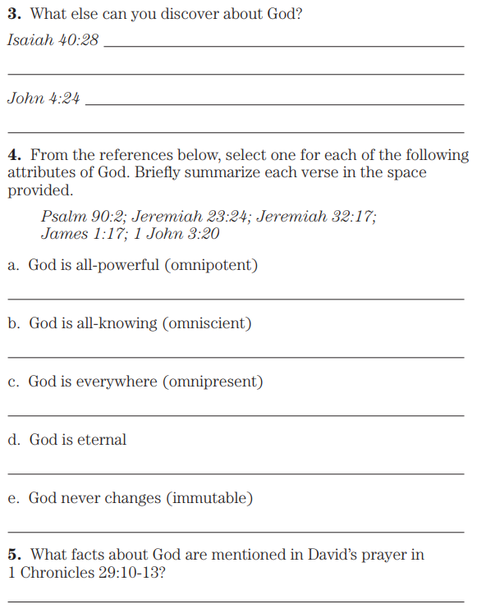
Isaiah 40:28 Do you not know? Have you not heard? The Everlasting God, Yahweh, the Creator of the ends of the earth, does not become weary or tired. His understanding is unsearchable.
John 4:24 God is spirit, and those who worship Him must worship in spirit and truth.”
Psalm 90:2 Before the mountains were born or You brought forth the earth and the world, even from everlasting to everlasting, You are God.
Jeremiah 23:24 Can a man hide himself in hiding places so I do not see him?” declares Yahweh. “Do I not fill the heavens and the earth?” declares Yahweh.
Jeremiah 32:17 ‘Ah Lord Yahweh! Behold, You have made the heavens and the earth by Your great power and by Your outstretched arm! Nothing is too difficult for You, James 1:17 Every good thing given and every perfect gift is from above, coming down from the Father of lights, with whom there is no variation or shifting shadow.
John 3:20 For everyone who does evil hates the Light, and does not come to the Light lest his deeds be exposed.
1 Chronicles 29:10 - 29:13

Slide 7
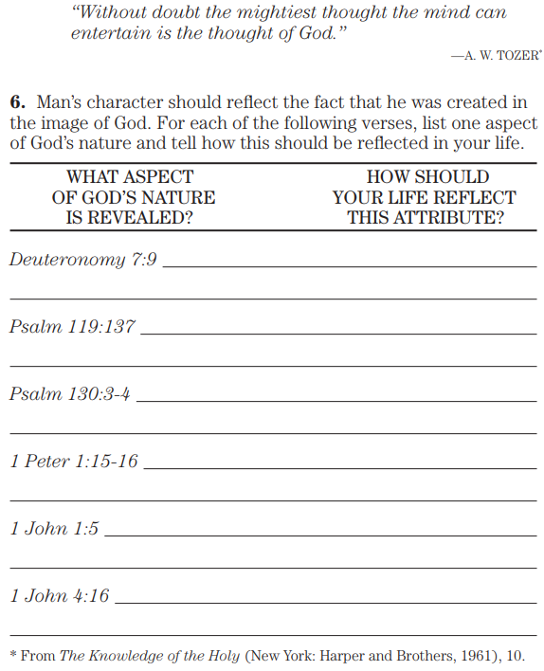
Deuteronomy 7:9 You shall know therefore that Yahweh your God, He is God, the faithful God, who keeps His covenant and His lovingkindness to a thousand generations with those who love Him and keep His commandments
Psalm 119:137 Righteous are You, O Yahweh, and upright are Your judgments.
Psalm 130:3 If You should keep iniquities, O Yah, O Lord, who could stand? 4 But with You there is forgiveness, that You may be feared.
1 Peter 1:15 but like the Holy One who called you, be holy yourselves also in all your conduct; 16 because it is written, “You shall be holy, for I am holy.”
1 John 1:5 And this is the message we have heard from Him and declare to you, that God is Light, and in Him there is no darkness at all.
1 John 4:16 And we have come to know and have believed the love which God has in us. God is love, and the one who abides in love abides in God, and God abides in him.

Slide 8
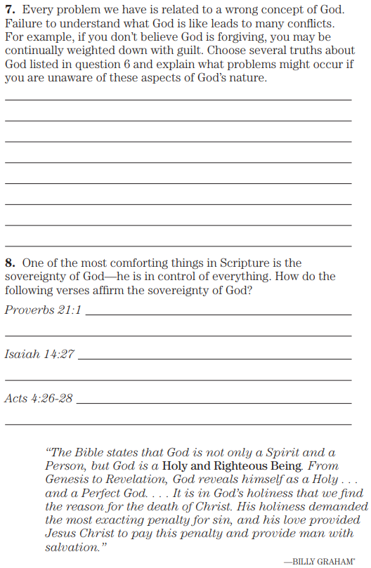
Proverbs 21:21 The king’s heart is like channels of water in the hand of Yahweh; He turns it wherever He pleases.
Isaiah 14:27 For Yahweh of hosts has counseled, and who can thwart it? And as for His stretched-out hand, who can turn it back?”
Acts 4:26 The kings of the earth took their stand, and the rulers were gathered together against the Lord and against His Christ.’ 27 For truly in this city there were gathered together against Your holy Servant Jesus, whom You anointed, both Herod and Pontius Pilate, along with the Gentiles and the peoples of Israel, 28 to do whatever Your hand and Your purpose predestined to occur.

Slide 9
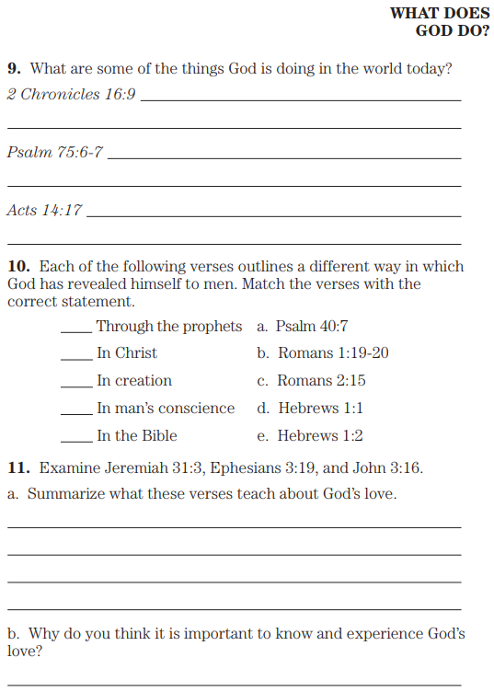
2 Chronicles 16:9 For the eyes of Yahweh move to and fro throughout the earth that He may strongly support those whose heart is wholly devoted to Him. You have acted foolishly in this. Indeed, from now on you will surely have wars.”
Psalm 75:6 For one’s rising up does not come from the east, nor from the west, and not from the desert; 7 But God is the Judge;
He puts down one and raises up another.
Acts 14:17 and yet He did not leave Himself without witness, in that He did good and gave you rains from heaven and fruitful seasons, filling your hearts with food and gladness.”
Psalm 40:7 Then I said, “Behold, I come; In the scroll of the book it is written of me.
Romans 1:19 because that which is known about God is evident within them; for God made it evident to them. 20 For since the creation of the world His invisible attributes, both His eternal power and divine nature, have been clearly seen, being understood through what has been made, so that they are without excuse.
Romans 2:15 in that they demonstrate the work of the Law written in their hearts, their conscience bearing witness and their thoughts alternately accusing or else defending them
Hebrews 1:1 God, having spoken long ago to the fathers in the prophets in many portions and in many ways, 2 in these last days spoke to us in His Son, whom He appointed heir of all things, through whom also He made the worlds

Slide 10
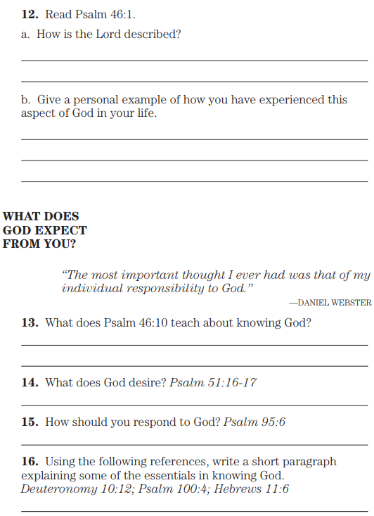
Psalm 46:1 God is our refuge and strength, a very present help in trouble... 10 “Cease striving and know that I am God;
I will be exalted among the nations, I will be exalted in the earth.”
Psalm 51:16 For You do not delight in sacrifice, otherwise I would give it; You are not pleased with burnt offering. 17 The sacrifices of God are a broken spirit; A broken and a contrite heart, O God, You will not despise.
Psalm 95:6 Come, let us worship and bow down, let us kneel before Yahweh our Maker.
Deuteronomy 10:12 “So now, Israel, what does Yahweh your God ask from you, but to fear Yahweh your God, to walk in all His ways and love Him, and to serve Yahweh your God with all your heart and with all your soul,
Psalm 100:4 Enter His gates with thanksgiving and His courts with praise. Give thanks to Him, bless His name.
Hebrews 11:6 And without faith it is impossible to please Him, for he who draws near to God must believe that He is and that He is a rewarder of those who seek Him.

Slide 11
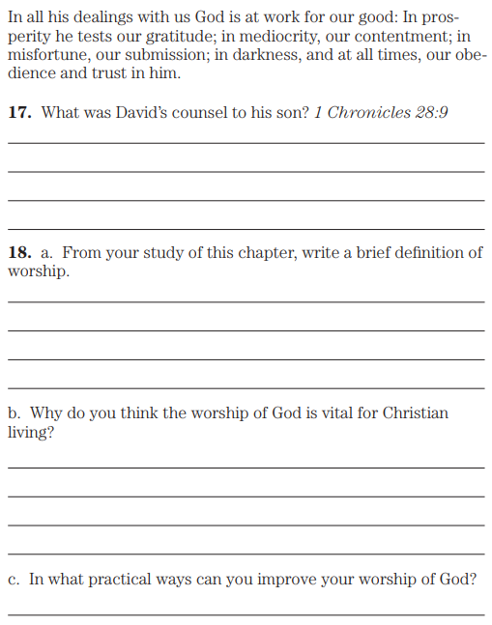
1 Chronicles 28: 9 “As for you, my son Solomon, know the God of your father, and serve Him with a whole heart and a delighted soul; for Yahweh searches all hearts, and understands every intent of the thoughts. If you seek Him, He will be found; but if you forsake Him, He will reject you forever.

